Slide 1
Card-inal Sin
Devon Grant, Long Hoang, Matt Izzo, Sara Earl

Slide 2
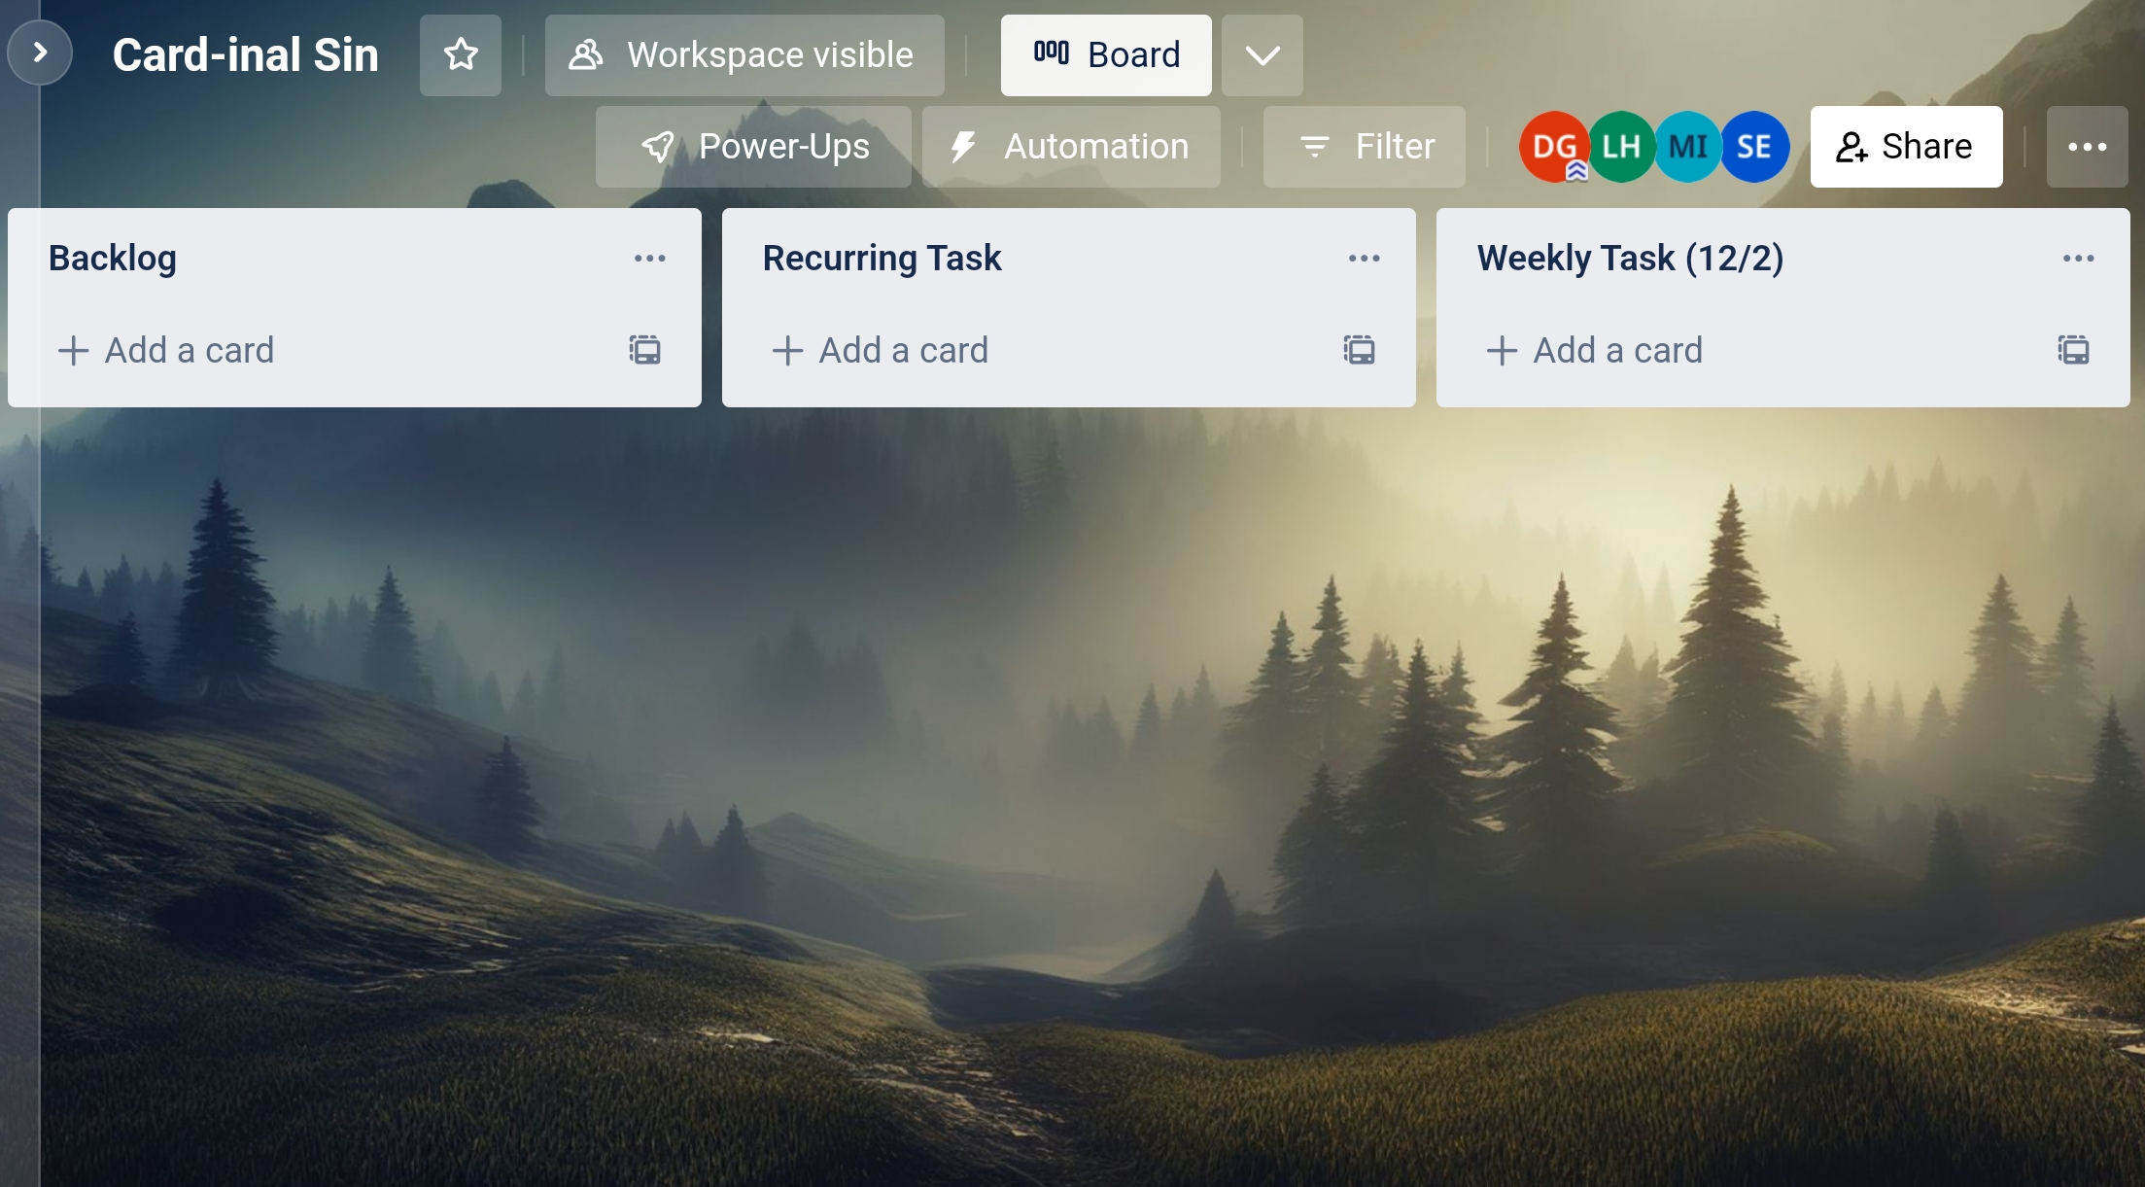
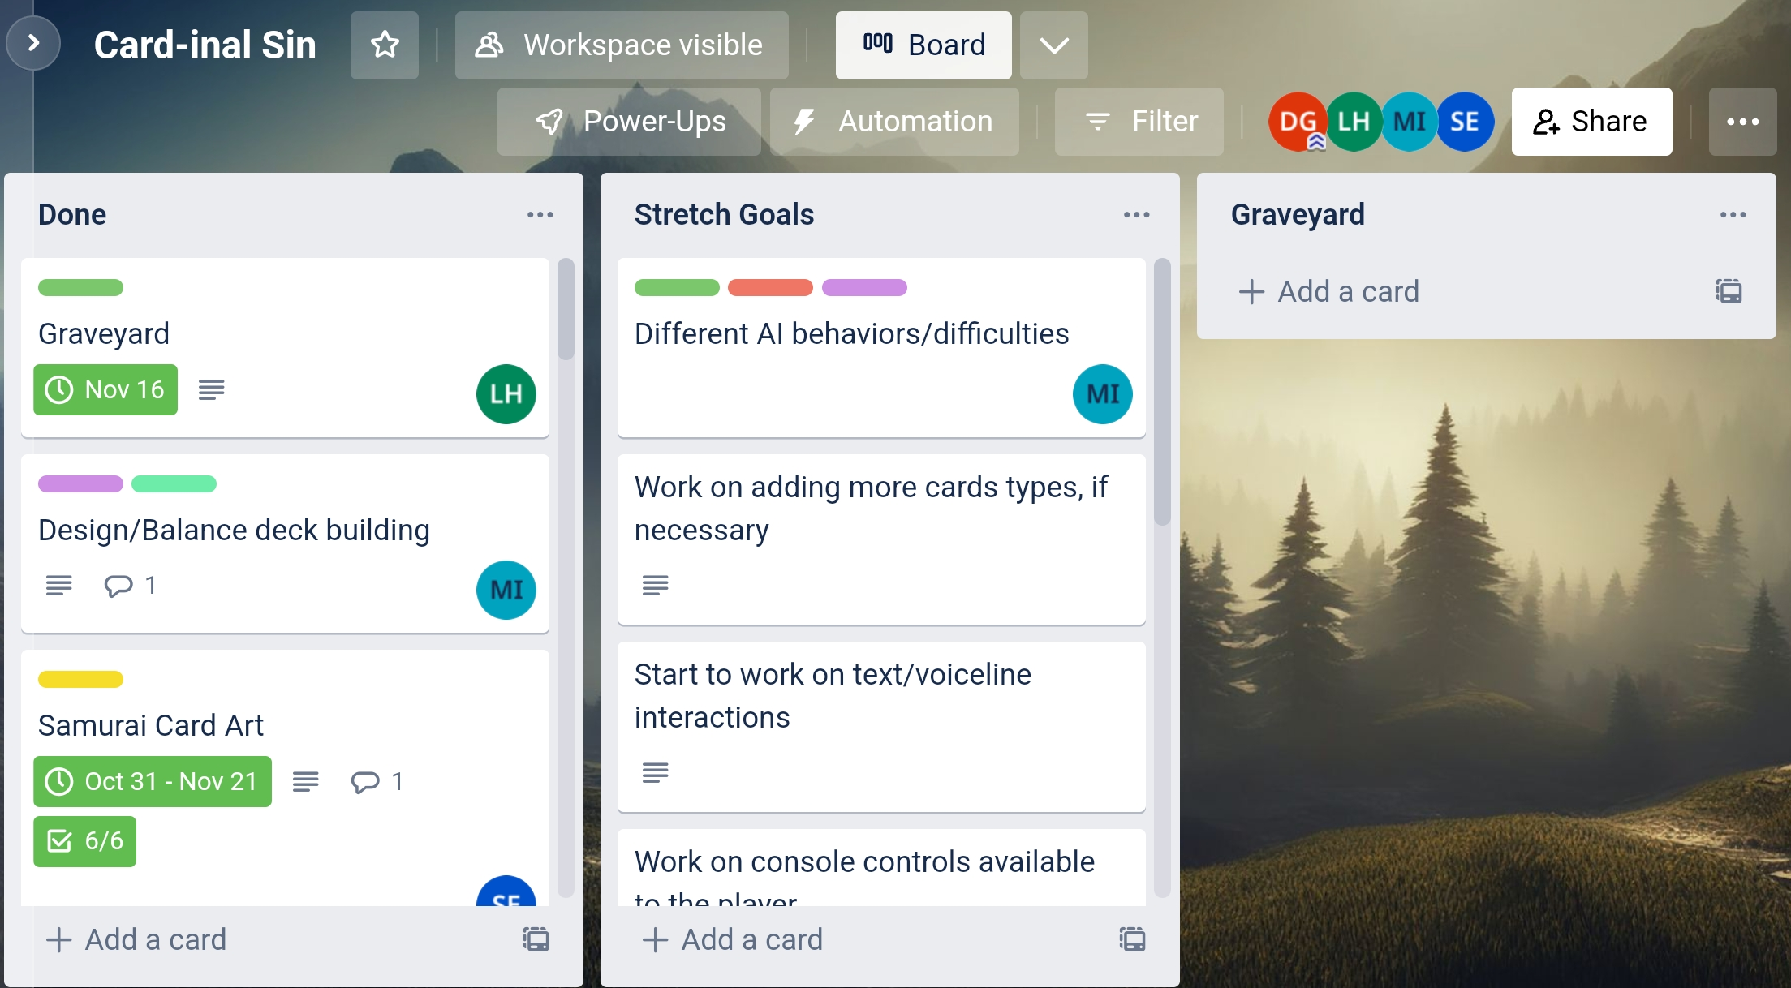

Slide 3
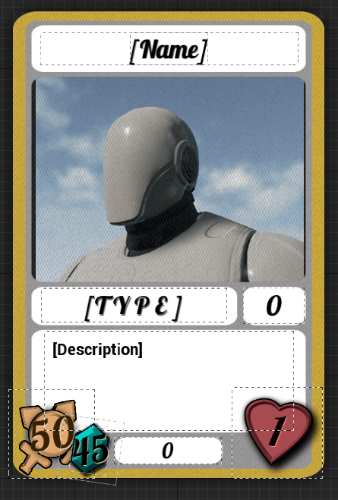
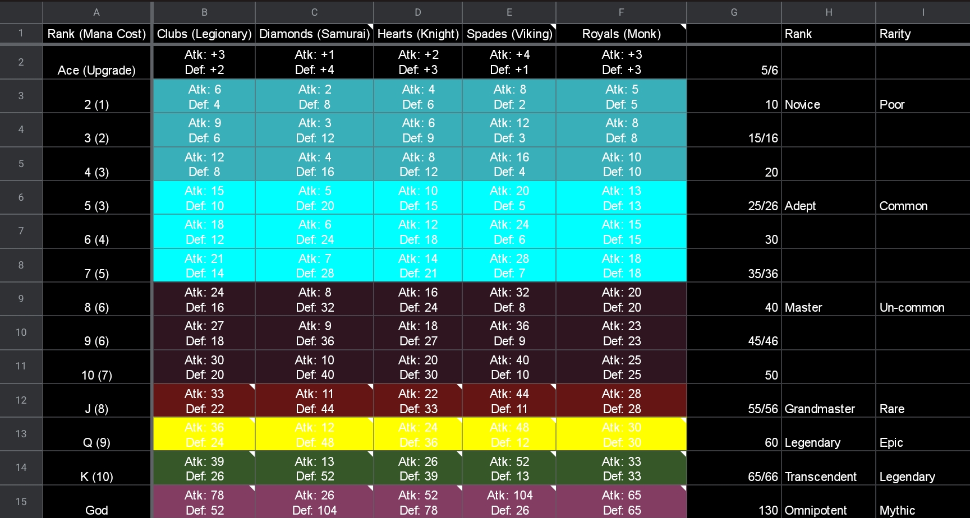
Game Design
Mana System
Starting amount: 5
Gain the same amount of Mana as turn number
Mana cost for attack as shown in card stats
Notes:
r

Slide 4
Game Design
Valor System
Valor
Killing an opponent's card gives you Valor equal to the sum of the target’s base health and attack
This includes retaliation kills
Valor is saved to the card
Valor cannot be gained through passive ability kills
Reclaimed Valor:
Killing an opponent's card that already has Valor will reward the attacking card with Valor equivalent to ⅓ of the target’s current Valor in addition to the amount they would normally gain.
Valorous Victory:
If the total Valor held by the cards on your side of the field is equal or greater than 280 you win
Notes:
r

Slide 5
Gameplay Programming
Abilities
The ability system are designed as modules to be added to each cards individually.
While it takes time to add the abilities to each cards, it is easier to debug whenever an ability is bugged or doesn’t work.
If we have more time, making a script to add abilities based on faction would be very useful.

Slide 6
General Programming
UI
A lot of the feedback we received were about new mechanics not being clear because of missing UI.
Added some necessary UI elements such as attack mana cost to cards, total Valour of all cards on the field, etc.
Some visual effects were added to make the abilities clearer.

Slide 7
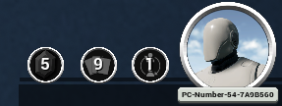
General Programming (Matt)
Mana
Small changes to cards
Added descriptions
Varying mana per attack
Revamped mana
Start with 5 mana
Gain mana = to the turn count
Cards cost different amounts of mana to attack with

Slide 8
AI Programming
AI Prioritizes Kills
Rescoped AI priorities to include newly added mechanics
Abilities
Valor
New mana system

Slide 9










Art Design
Unit art completed for all factions!
Backgrounds included
Each faction has a unique palette and background

Slide 10
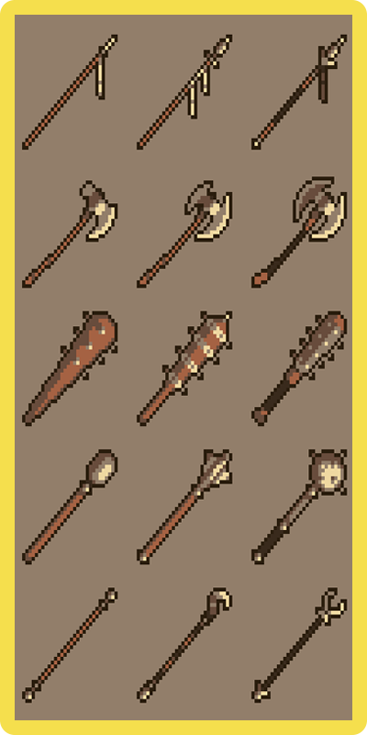
Art Design (Con’t)
Finished cardback art
Finished collecting audio assets
https://freesound.org/
https://freesound.org/people/Garuda1982/sounds/662446/
https://drive.google.com/file/d/1KHClJr2VgG7hyl0wyK_3zFQZD8VUgedY/view?usp=drivesdk

Slide 11


Slide 12
Lessons Learned
The biggest lesson I have learned this semester is don’t be too ambitious with the MVP, I have to better manage my time as well as be more realistic with scheduling. Oftentimes we had to readjust the timeline. It would have been more efficient if I better accounted for the delays of life ahead of time and left more wiggle room for such occurrences - Devon
The biggest lesson I learnt from the project is the importance of time management. I have a lot of homeworks and projects for this semester, and so it’s hard to find time to work on the projects. I also learnt that I should have taken more time to look into the source code more, especially when we are using a complicated source code like the CCG Toolkit. - Long
Readjusting scope to add new features like mana, abilities, and valor meant that the AI had to be rescoped, which was something I did not really foresee needing to be done. They added quite a bit of time into the improving AI process - Matt
I need a lot more practice to be able to make decent estimates for not just how long things will take in actual converted effort, but how long it'll be before I can get to it, and work on estimating my energy/effort budget and how much I can actually commit to stuff instead of just overpromising and trying to make those goals -Sara

Slide 13


Card-inal Sin
Devon - Lead Designer
Long - Lead Programmer
Matt - Lead AI
Sara - Lead Artist

Slide 14
Q&A

Slide 15
If you've seen this slide you've gone too far, turn back now
Links:
https://github.com/Long-T-Hoang/CardinalSin
https://drive.google.com/file/d/1-L51624LYs8uVI5pM7nBuKAVM1YOBKvc/view?usp=share_link

